Slide 1

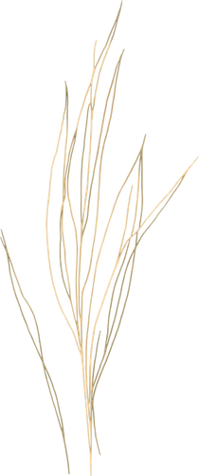

SYNTHETIC DATASET CREATION FOR
CO-EXISTING
DISEASES IN RICE LEAF
Mentor: Prof.Swetha Patil
Team: 9
Nidhi C R Jayashree D
PES2UG23CS382 PES2UG24CS203

Slide 2


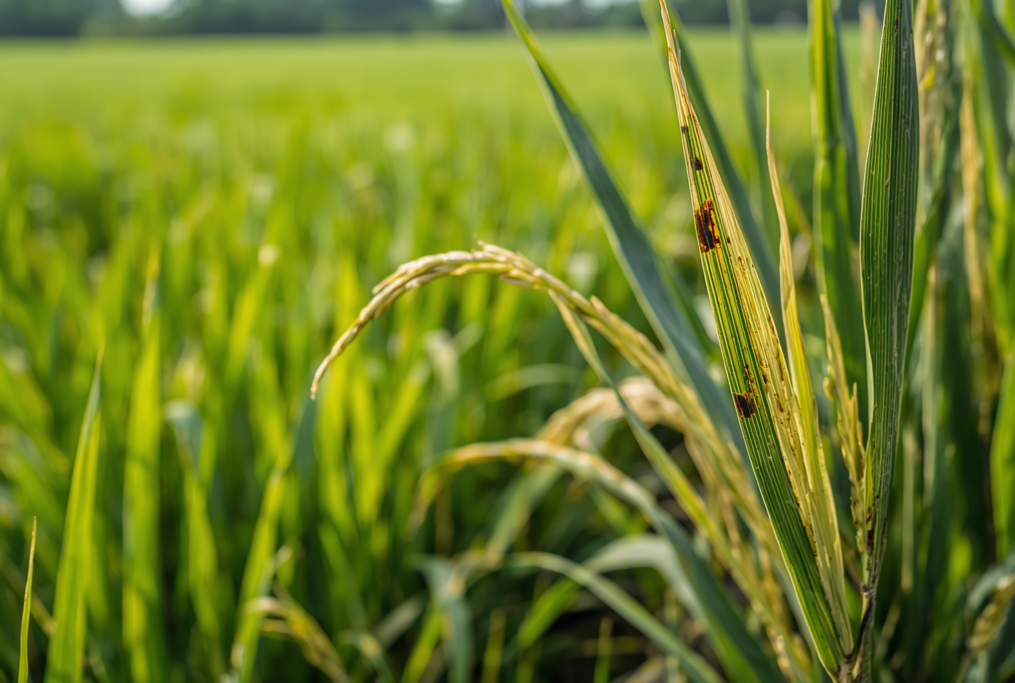
PROBLEM STATEMENT
Existing rice leaf disease datasets primarily contain images of individual leaves affected by a single disease. While these datasets are widely used for disease analysis and model development, they do not adequately represent real-world field conditions where multiple diseases can occur simultaneously on the same leaf. The absence of publicly available multi-disease rice leaf datasets creates a significant gap in agricultural image resources and limits research on disease co-occurrence and multi-disease analysis.
Therefore, there is a need for a dedicated
dataset containing rice leaf images
exhibiting multiple diseases on a single leaf.

Slide 3
LITERATURE SURVEY
Relevance to Project | Limitation | Sl.No | Paper | Technique / Method
Source dataset for BLB, Blast and Brown Spot | Single-disease images only | 1 | Paddy Doctor (2022) | Rice disease dataset creation & benchmarking
Supports multi-label disease learning | Tomato domain | 2 | Advanced Multi-Label Tomato Leaf Disease Identification (2025) | ViT + EfficientNet + Multi-label Classification
Closest reference to multi-disease recognition | Different crop species | 3 | Mixed Disease Recognition in Apple Leaves (2026) | Multi-task Learning
Lesion segmentation baseline | Sensitive to illumination variation | 4 | Otsu Multi-Threshold Image Segmentation (2023) | Otsu Thresholding
Disease patch boundary extraction | Traditional method | 5 | Recognition System for Leaf Images (2017) | Contour Detection
Key technique for dataset creation | Not agriculture-specific | 6 | Simple Copy-Paste Augmentation (2021) | Copy-Paste Augmentation
Direct inspiration for lesion insertion | Medical domain | 7 | Copy-Paste with Poisson Blending (2023) | Copy-Paste + Poisson Blending
Dataset quality validation | Not plant-specific | 8 | Image Quality Assessment Study (2019) | SSIM, PSNR, MSE, FSIM

Slide 4


RESEARCH GAPS
  Lack of Multi-Disease Rice Leaf Datasets
    Existing rice disease datasets mainly contain single-leaf, single-disease images.
  Poor Representation of Real Field Conditions
    Current datasets do not adequately capture disease co-occurrence observed in agricultural fields.
  Limited Rice-Specific Multi-Label Resources
    Most multi-label disease studies focus on crops such as tomato and apple rather than rice.
  Emphasis on Classification Over Dataset Development
    Existing research primarily develops disease detection models instead of creating new datasets.
  Limited Use of Image Synthesis for Dataset Expansion
    Advanced image synthesis techniques are rarely used to generate multi-disease rice leaf samples.
Link to Literature survey: https://docs.google.com/document/d/1U6dRgOOEHdJRo7HXQe3yd6fVf56FgcEmLZLIPw_5YO0/edit?usp=sharing

Slide 5

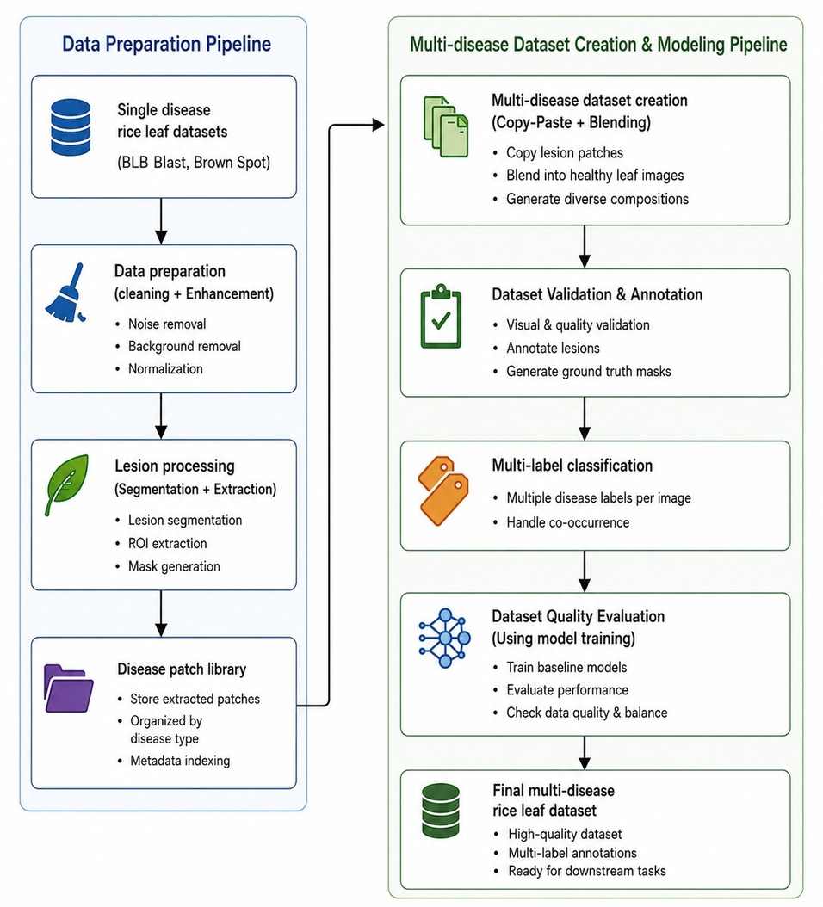
SYSTEM ARCHITECTURE
  Single-disease rice leaf datasets are collected and preprocessed through cleaning and image enhancement techniques.
  Disease lesions are segmented and extracted to create a disease patch library for further processing.
  Extracted disease patches are combined using copy-paste augmentation and blending techniques to generate multi-disease rice leaf images.
  The generated images are validated, annotated, and organized into a multi-label dataset.
  Multi-label classification models are used to evaluate dataset quality and verify the effectiveness of the created dataset.

Slide 6
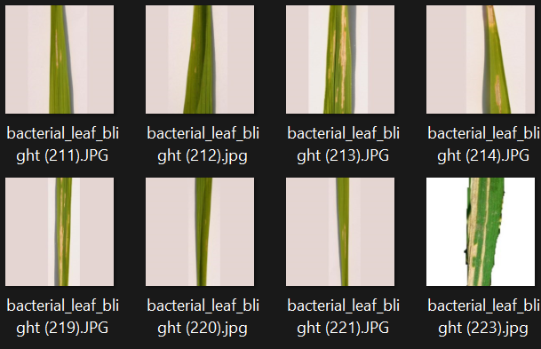
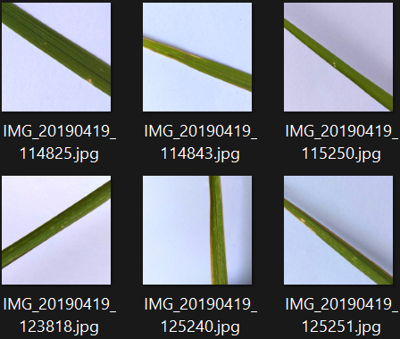
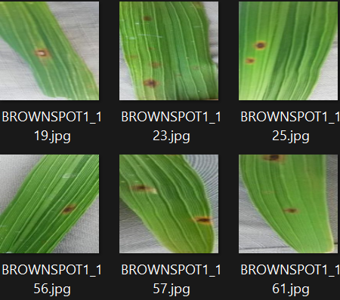
DATASET
Bacterial Leaf Blight(1076)
Leaf Blast(1560)
Brown Spot(1392)
Dataset Source:
  https://www.kaggle.com/datasets/chaitanyakamble69/rice-leaf-disease-riceguard-19k-cleaned
  https://www.kaggle.com/datasets/alamshihab075/rice-leaf-disease-an-images-dataset
  https://www.kaggle.com/datasets/mdmehedihasan19/rice-leaf-disease-dataset
  https://www.kaggle.com/datasets/sdeysocial/rice-leaf-disease-image-samples?select=Rice+Leaf+Disease+Images

Slide 7

APPLICATIONS & USE CASES
  Multi-Disease Detection Research
    Supports the development and evaluation of machine learning and deep learning models for identifying multiple diseases on a single rice leaf.
  Benchmarking Multi-Label Classification Models
    Provides a dataset for testing and comparing the performance of multi-label disease classification algorithms.
  Agricultural Decision Support Systems
    Serves as a valuable data resource for future disease diagnosis and crop health monitoring applications.
  Study of Disease Co-Occurrence
    Enables researchers to analyze the occurrence and visual interaction of multiple diseases on the same rice leaf.
  Precision Agriculture Applications
    Contributes to the development of intelligent crop monitoring systems for improved disease management and yield protection.

Slide 8



THANK
YOU!

